Slide 1
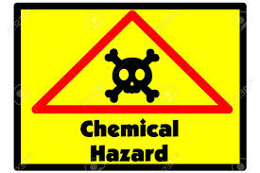
c
CHEMICAL PLANT SAFETY
UNIT-2

Slide 2
Hazard
A hazard is generally anything that can hurt you or make you ill.

Slide 3
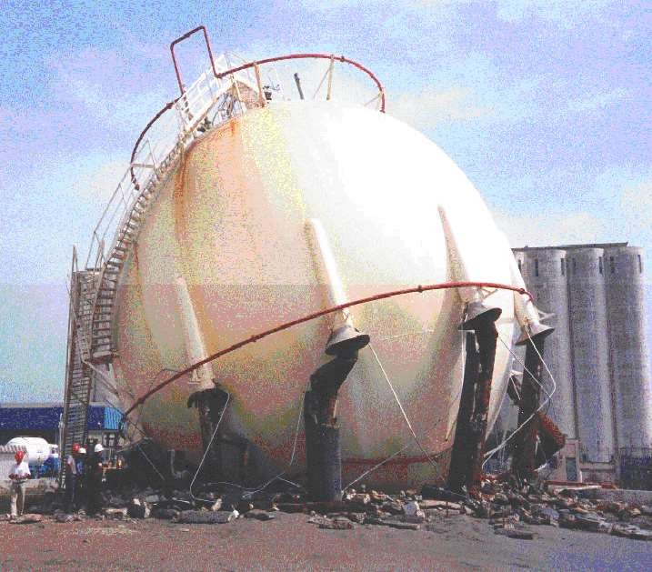

Slide 4
Hazardous chemical
A material that has physical or chemical characteristic of potential for causing harm
human injury,
damage to property,
damage to environment
or some combination of these is known as hazardous chemical.

Slide 5
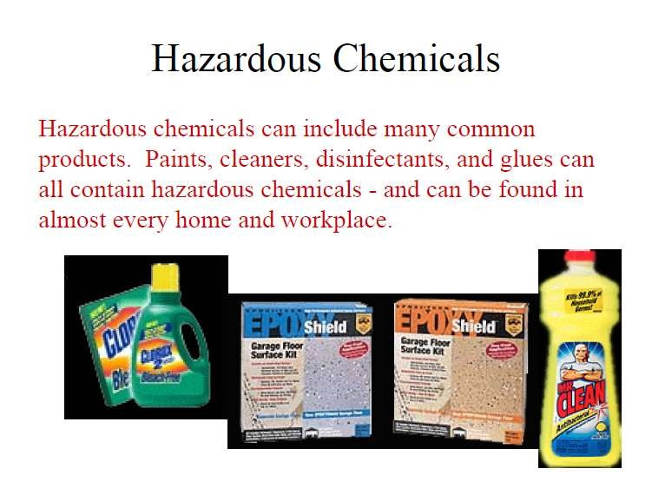

Slide 6
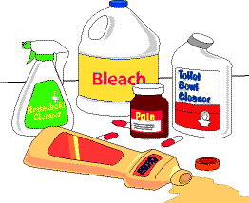
Hazardous chemicals

Slide 7
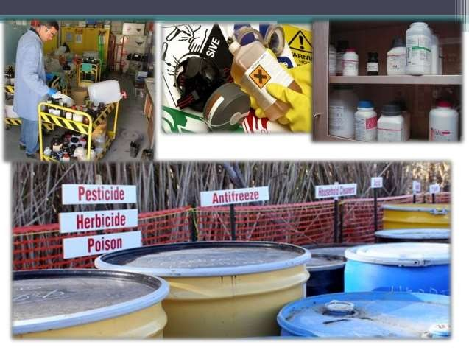
Hazardous chemicals

Slide 8
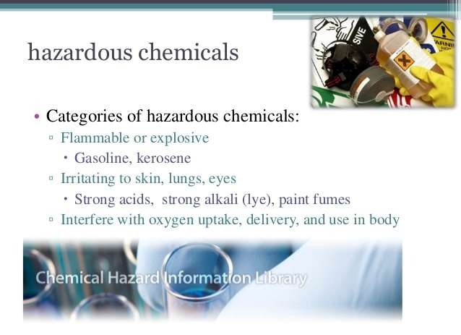

Slide 9
Chemical Hazard
The undesired effects which are caused with the absorption of hazardous chemicals by the human body- are called chemical hazards.
The hazardous chemicals
alone in with other
concentration, or when mixed
chemical substance, can cause injury, disease or death.

Slide 10
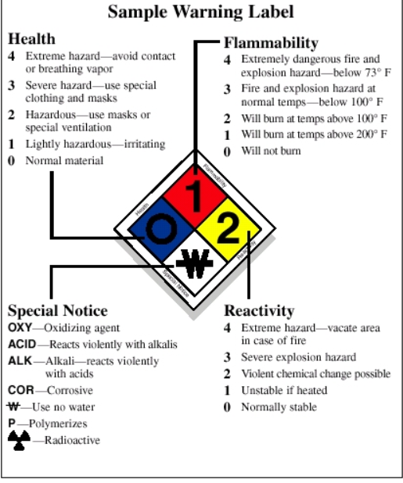
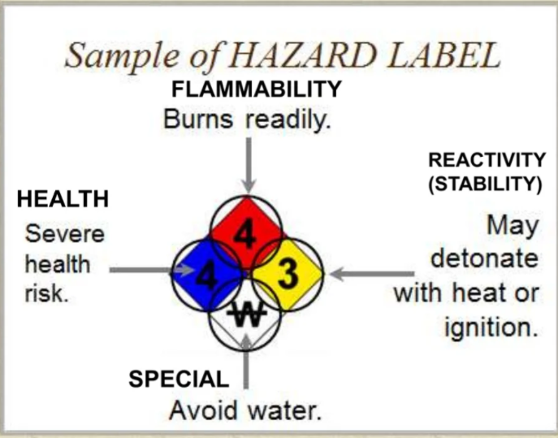
Hazard label – NFPA (National fire protection Association) Diamond

Slide 11
TYPES OF CHEMICAL HAZARD
HEALTH HAZARD- Health hazards are chemical, physical or biological factors in our environment that can have negative impacts on our short- or long-term health
PHYSICAL HAZARD- Physical hazard are based on the intrinsic properties of the chemical.

Slide 12
PHYSICAL HAZARD
Flammable gases
Flammable aerosols
Oxidizing gases
Gases under pressure
Flammable liquids
Flammable solids
Self-reactive substances and mixtures
Pyrophoric liquids
contact with water, emit flammable gases
Oxidizing liquids
Oxidizing solids
Organic peroxides
Corrosive to metals
Combustible dusts
Pyrophoric gases

Slide 13
HEALTH HAZARD
Acute toxicity
Skin
corrosion/irritation
Serious eye damage/eye irritation
Respiratory or skin sensitization
Germ cell mutagenicity
Carcinogenicity
Reproductive toxicity
Specific target organ toxicity – single exposure
Specific target organ toxicity – repeated exposure
Aspiration hazard
Bio hazardous infectious materials

Slide 14
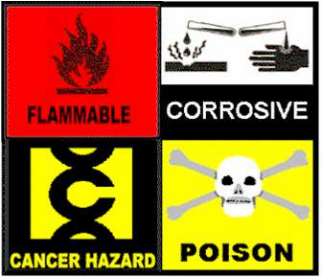

Slide 15
Types Of Chemical Hazard
Naturally Occurring Chemicals
Ex. Mycrotoxin, Pyrrolizidine Alkaloides Intentionally Added Chemicals
Ex. Preservatives: Nitrite and Sulfiting agents. Unintentionally Or Incidentally Added Chemicals Ex. Pesticides, Lead, Arsenic, Mercury.

Slide 16
WHMIS
Workplace Hazardous Materials Information System Goals-
Prevent Health Hazards
Reduce Accidents

Slide 17

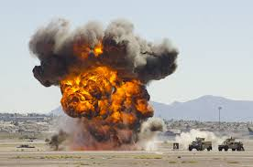

CLASSIFICATION OF DANGEROUS GOODS/CHEMICALS –under motor vehicle rules 1989
CLASS 1- EXPLOSIVES
An explosive substance is a solid or liquid substance which itself capable of producing chemical reactions and gas at such a temperature, pressure and speed to cause damage to surroundings
Causes:
Mass explosion hazard
Projection hazard
Fire hazard and either minor blast hazard or minor projection hazard
Give rise to radiant heat
Burn one after another producing minor blast

Slide 18

CLASS 2 – GASES: COMPRESSED, LIQUIFIED OR DISSOLVED UNDER PRESSURE
2.1 Flammable gases – Chemical which mixes in air in its gaseous state at normal pressure and becomes flammable. Its BP at normal pressure is below 20 °C
2.2 Non Flammable, Non toxic gases - gases which are transported at a pressure not less than 286 kPa at 20 °C or as refrigerated liquid and which are asphyxiant or oxidizing
2.3 Toxic Gases – toxic or corrosive to humans as they pose a hazard to health (LC₅₀ value =< 5000ppm

Slide 19
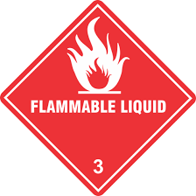
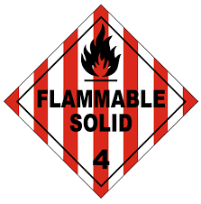
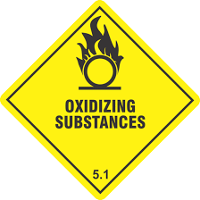
CLASS 3 – FLAMMABLE LIQUIDS
These are liquids or a mixtures of liquids / liquids containing solids in solution or suspension which has a flash point <61 °C
CLASS 4
4.1 Flammable solids (easy ignition by external sources such as sparks, flames)
4.2 Spontaneously combustible (spontaneous heating under normal conditions, heating up in contact with air)
4.3 Dangerous when wet (liq/sol interact with water – flammable spontaneous)
CLASS 5
5.1 Oxidizing substances (directly/indirectly evolve oxygen
5.2 Organic peroxides – liable to exothermic decomposition at normal/elevated temp

Slide 20
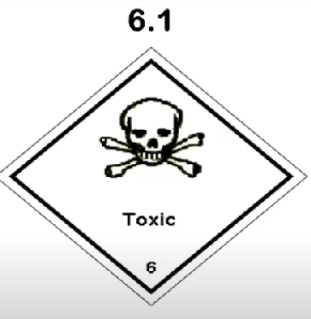
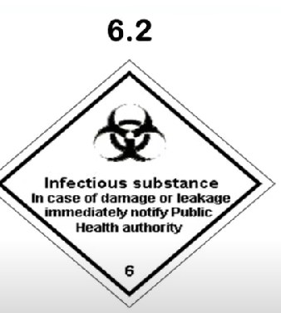
CLASS 6:
6.1 Toxic substances – liable either to cause death/serious injury /harm human health
6.2 Infectious substances – containing viable microorganisms, including bacterium, virus, parasite, fungus causes diseases to human & animals
CLASS 7:
Radioactive materials – spontaneously emit radiation
CLASS 8:
Corrosives – severely damaging living tissues
CLASS 9:
Miscellaneous Dangerous substances and articles
Substances not falling with other classes /divisions
Lachrymatory substances not falling with other classes

Slide 21
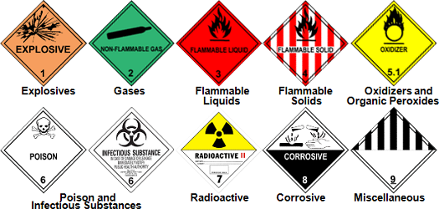
Hazardous Material Description

Slide 22
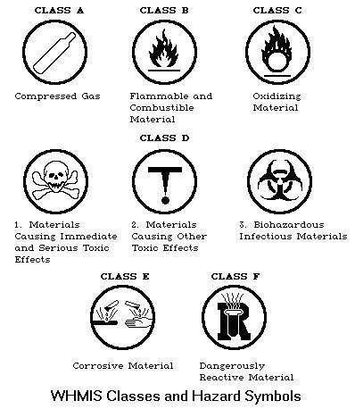

Slide 23
Effect of chemicals depends on several factors
The routes of entry
The physical properties of the substances
Work practices
The nature of the exposure
Combined exposures
The susceptibility of workers
Toxicity

Slide 24
Effect Of Chemicals
Causing irritation
Allergies
Lack of oxygen
Systemic poisoning
Cancer
Damage to the unborn fetus
Effects on the future generations
Pneumoconiosis (Dusty lung)

Slide 25
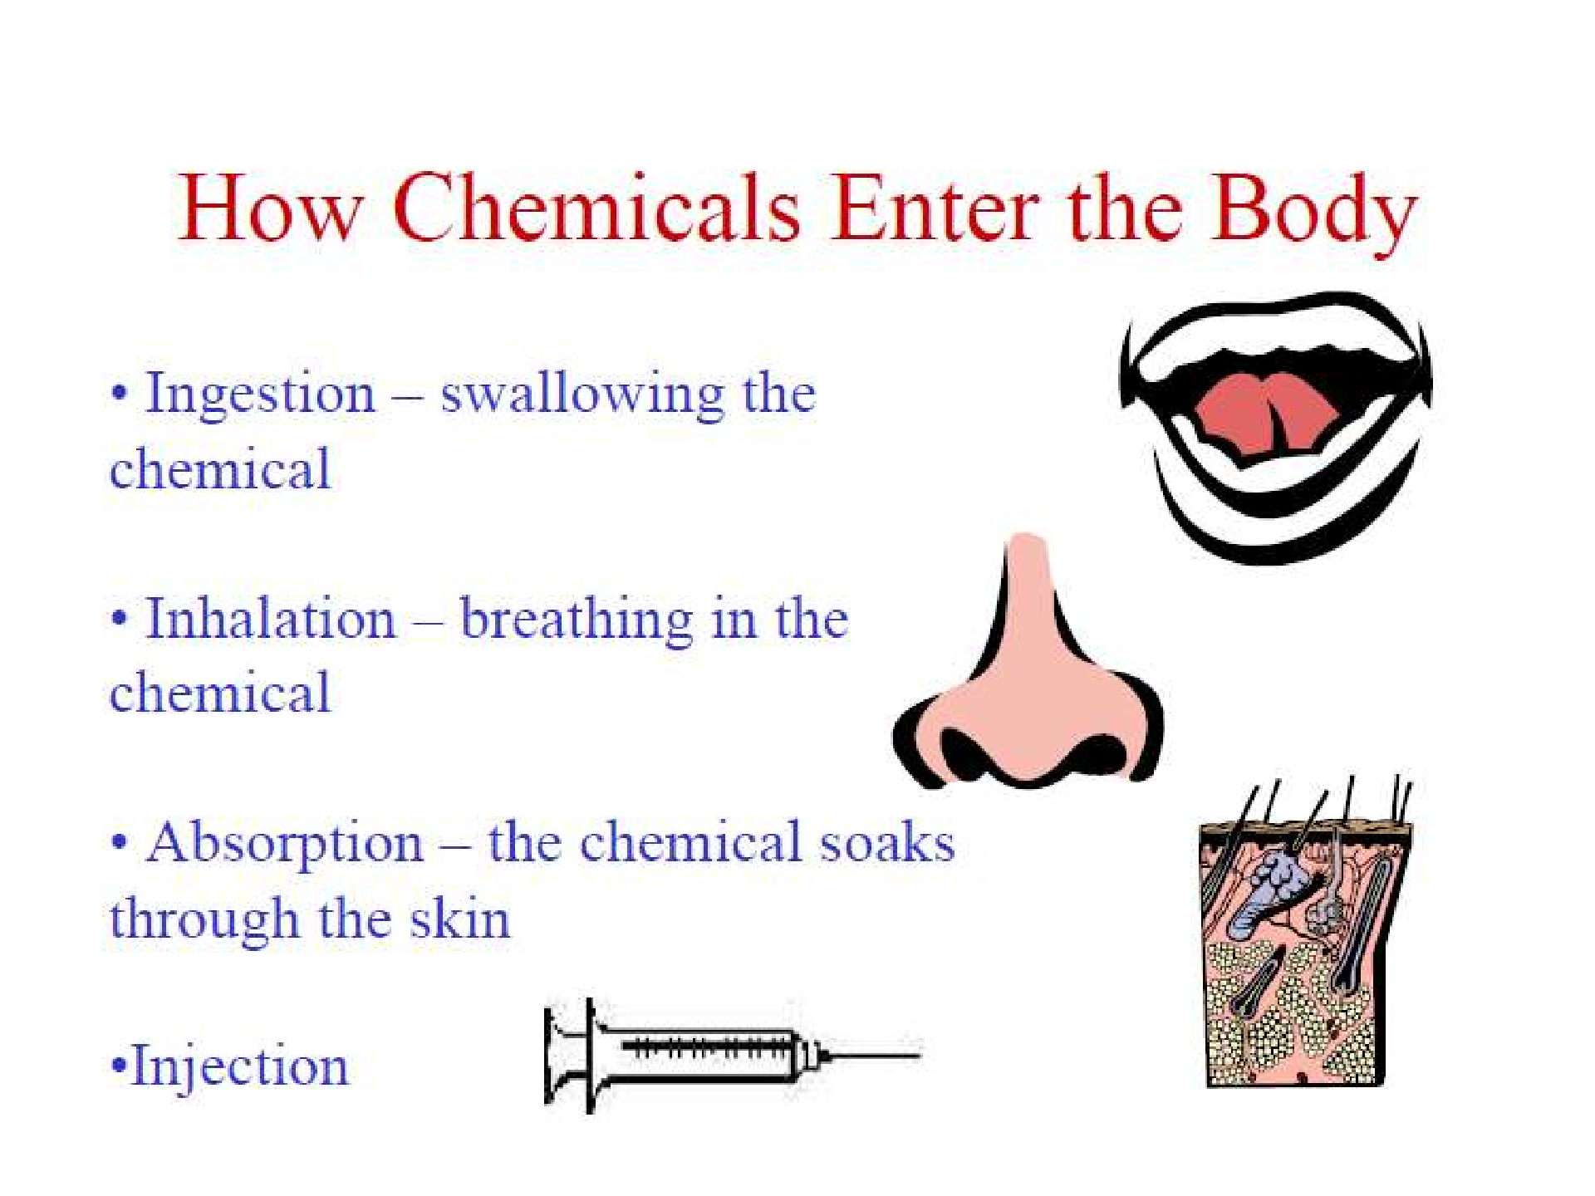

Slide 26
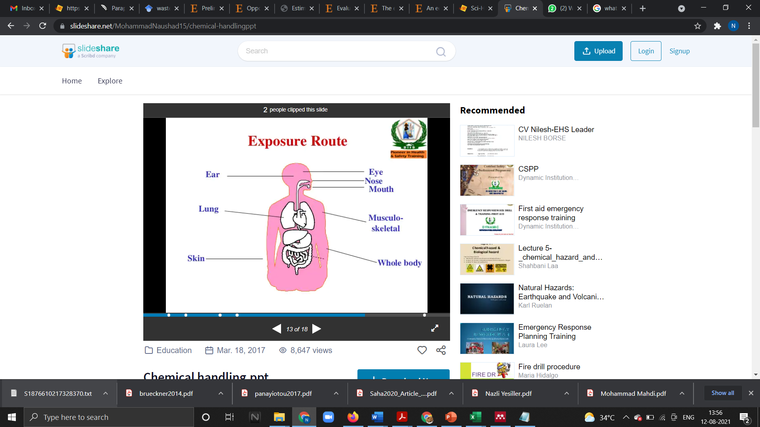
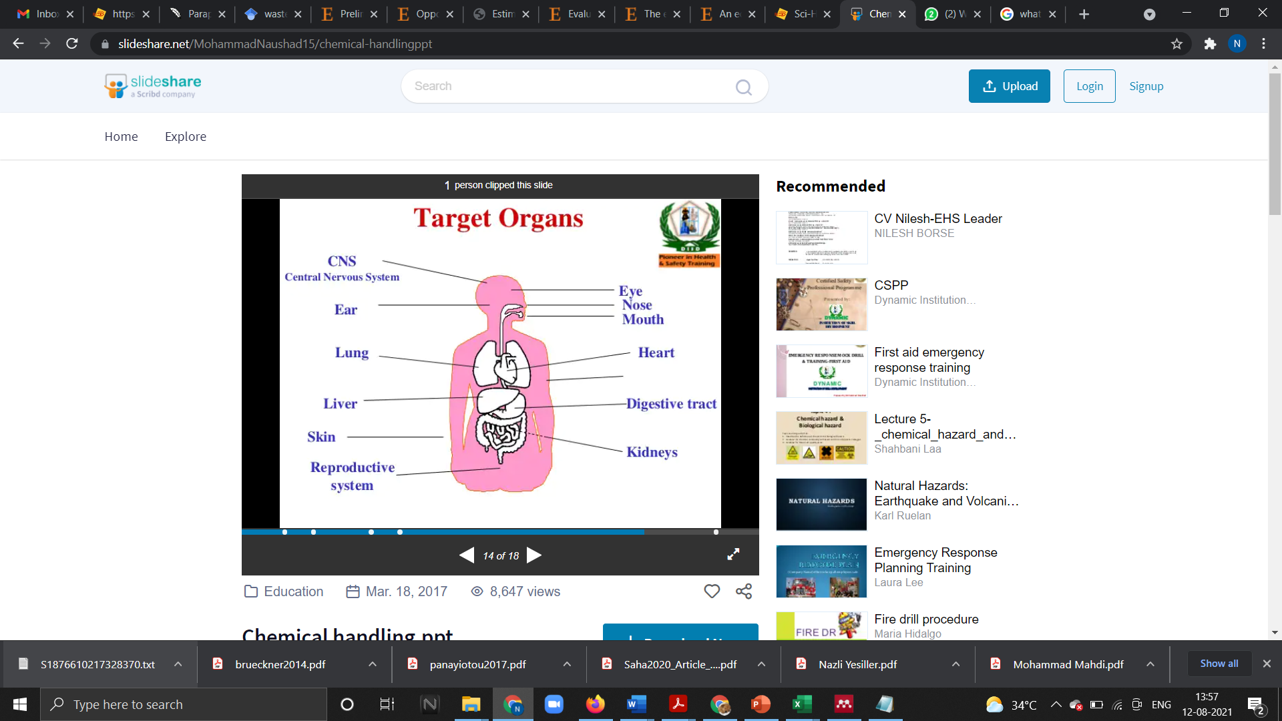

Slide 27
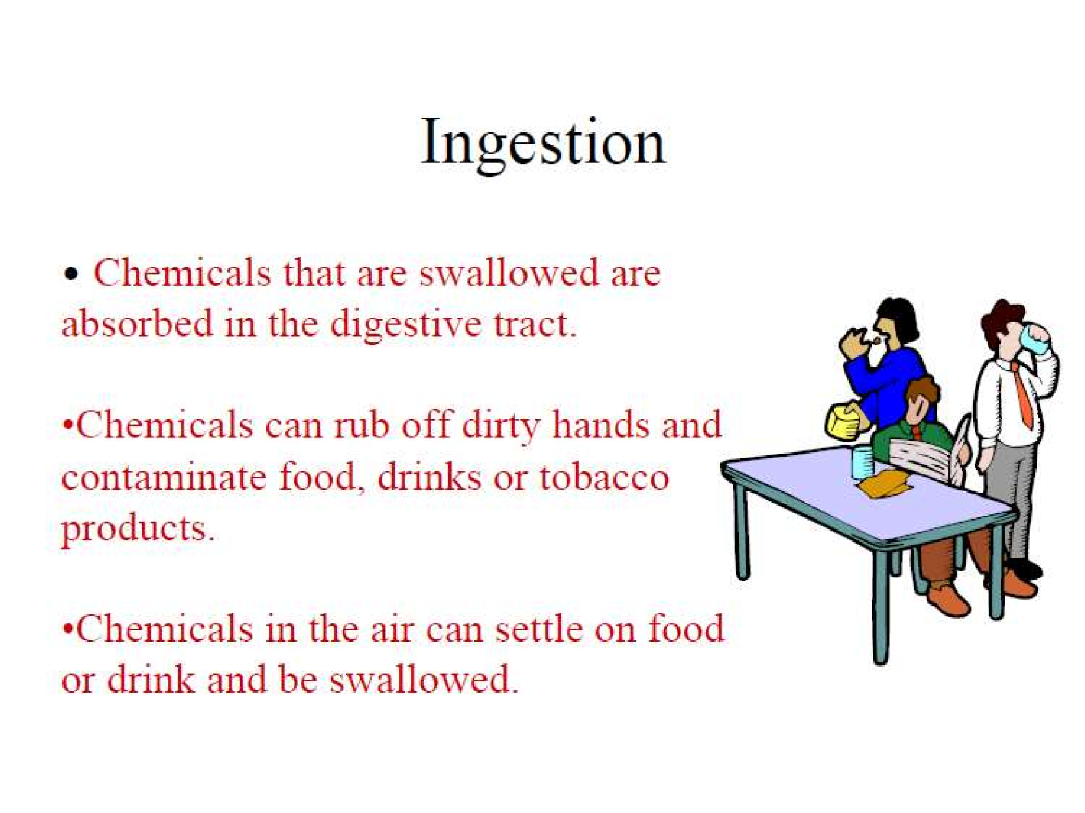

Slide 28
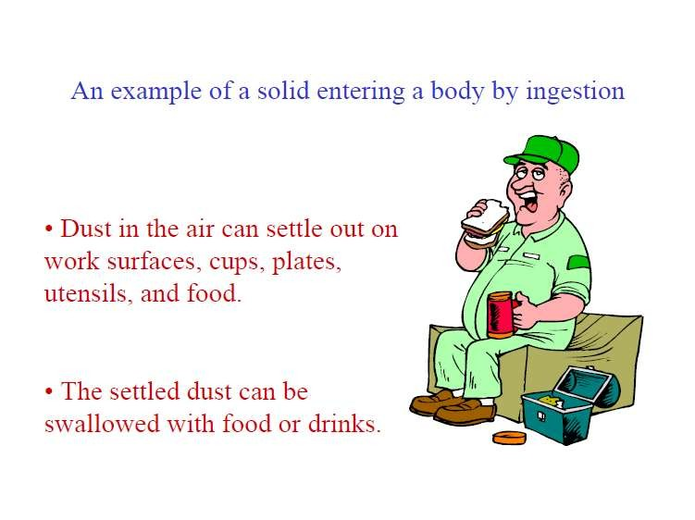

Slide 29
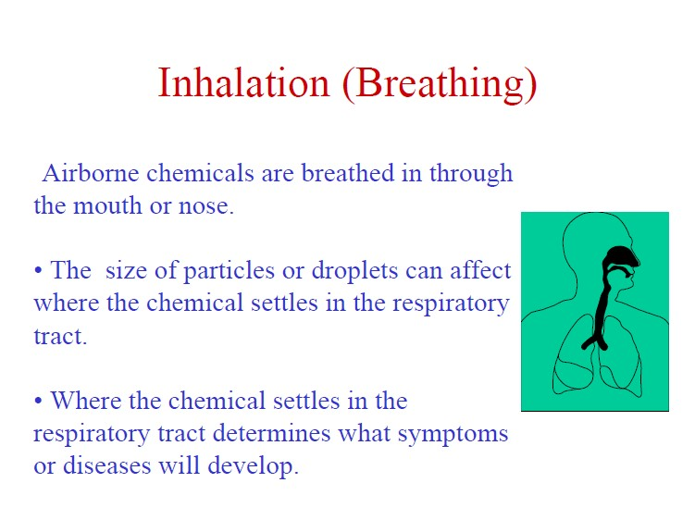

Slide 30
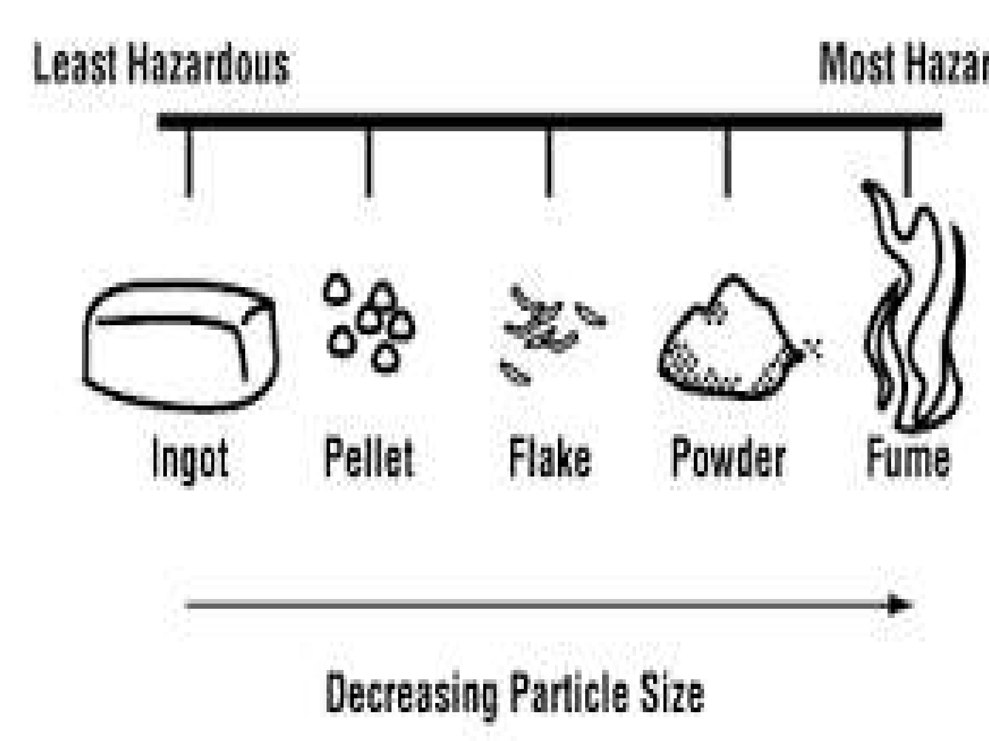

Slide 31
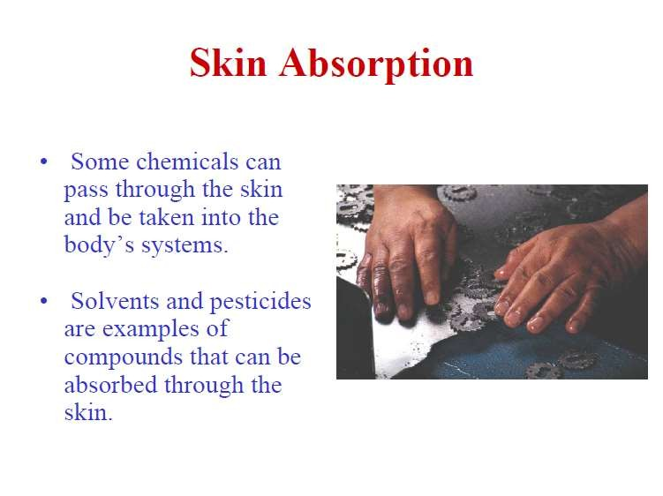

Slide 32
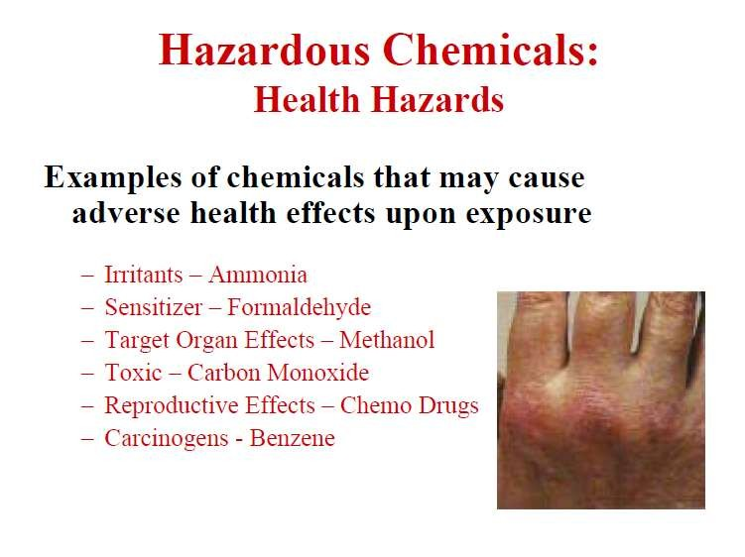

Slide 33
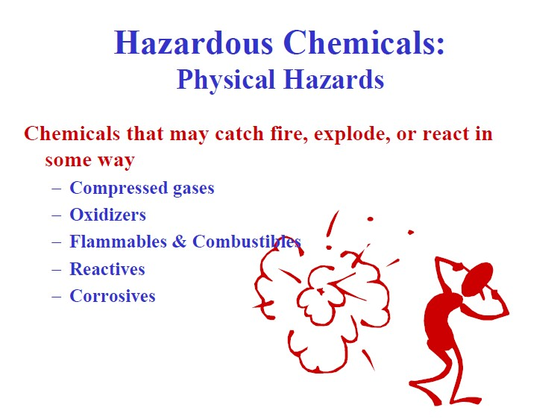

Slide 34
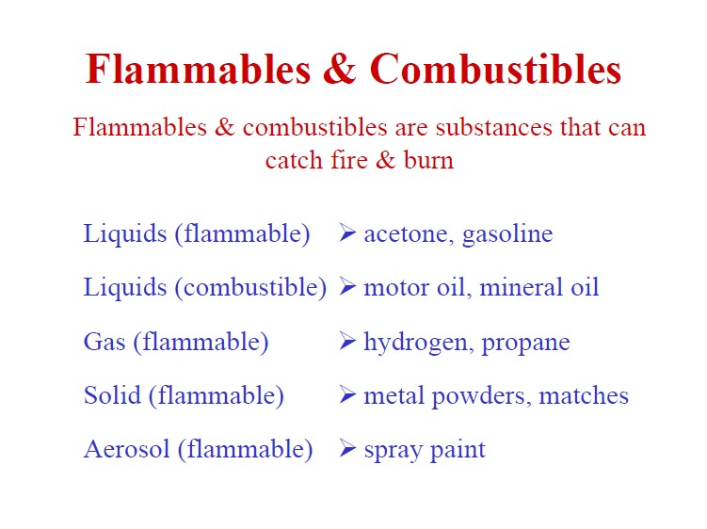

Slide 35
Handling of chemicals

Slide 36
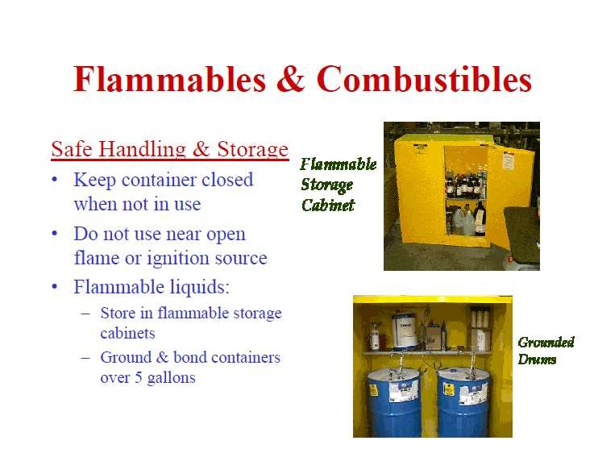

Slide 37
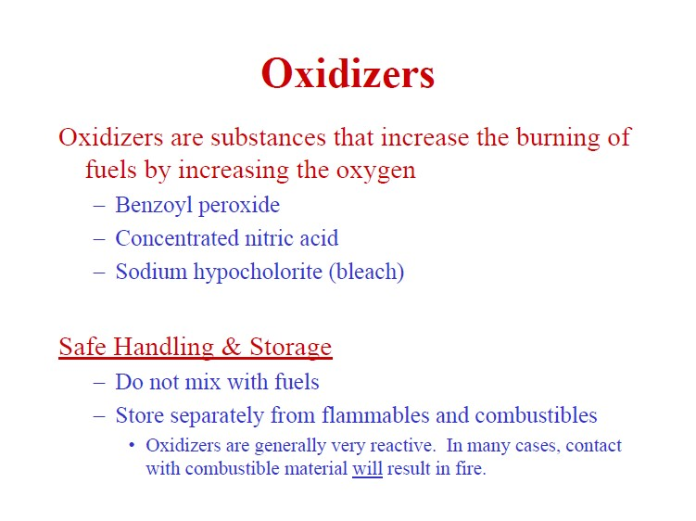

Slide 38
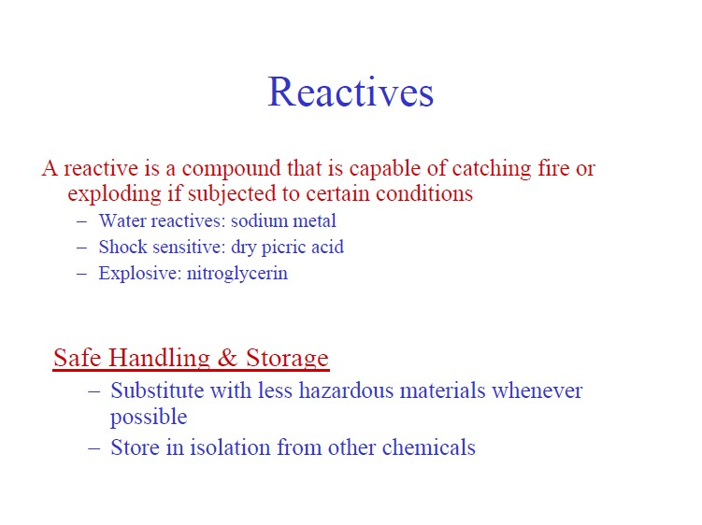

Slide 39
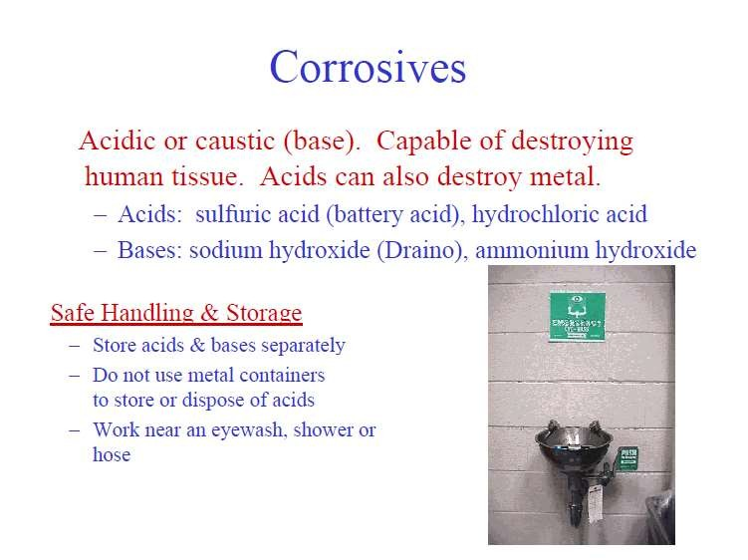

Slide 40
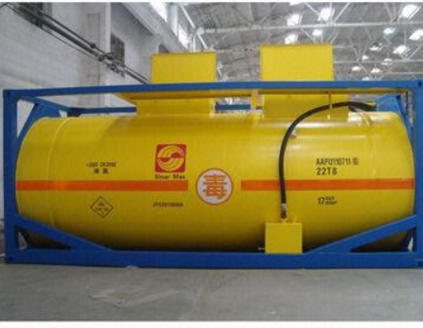
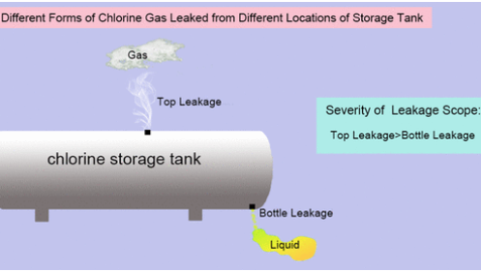
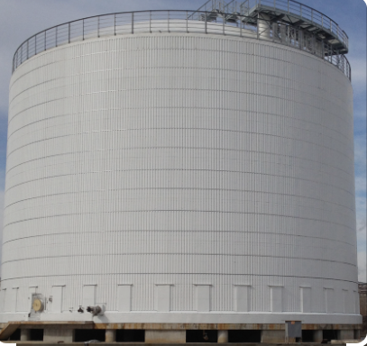
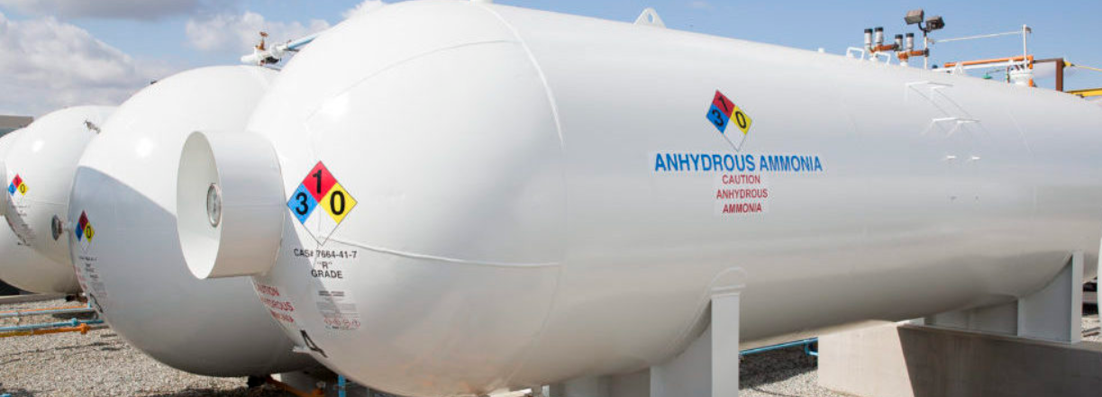
Storage Inspection
General information:
Name and location of storage
Name and address of the occupier
Availability of safety data sheet
Chlorine storage tanks
Details of storage
Year of installation
Capacity in tons
Material of construction
Relevant standard
Type pf protective painting
Designed pressure and temperature
Working pressure and temperature
Safety device against over pressure
Safety device against temperature, liquid level
Details of venting system
Ammonia storage tanks
Double walled Ammonia storage tank

Slide 41
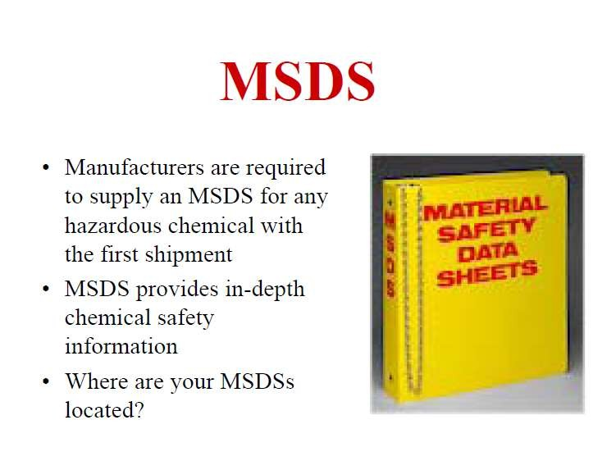

Slide 42
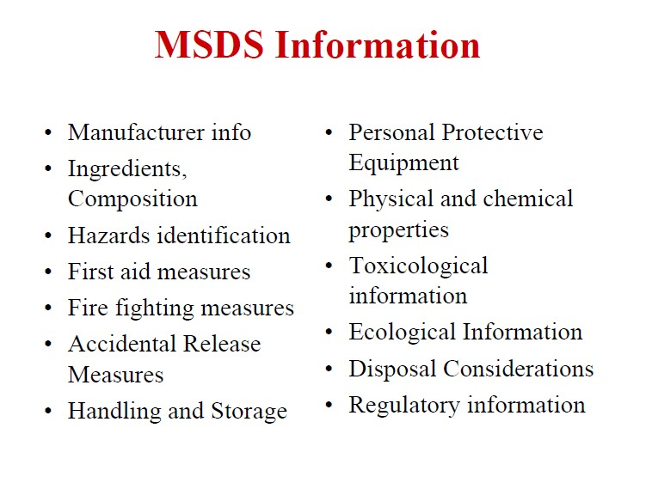

Slide 43
Controlling Chemical Hazards in the Workplace
•
Reduce or eliminate the use of hazardous chemicals whenever possible.
•
Maintain adequate ventilation systems to reduce concentrations of airborne chemicals.
Practicing good personal hygiene (e.g. washing hands) and maintaining regular workplace cleaning routines.
•
•
Learn how to avoid carrying hazardous substances home.

Slide 44
Introduce administrative controls to minimize exposure to chemicals (e.g. rotate workers through different jobs or locations.
Perform maintenance work in off-hours so that accidental release of toxic substances will affect fewer workers).
Use personal protective equipment and devices.
Maintain equipment in good order to prevent leaks and breakdowns that may release toxic substances.

Slide 45
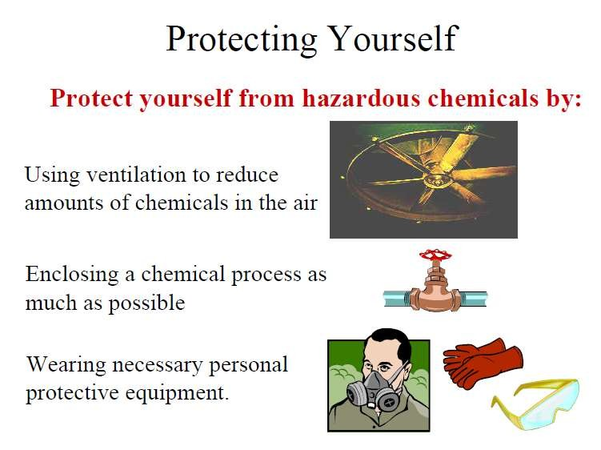

Slide 46
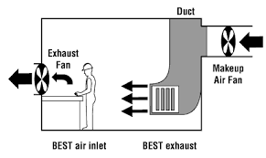

Slide 47
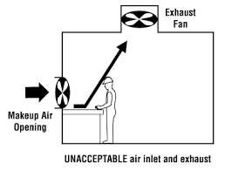

Slide 48
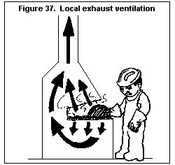

Slide 49
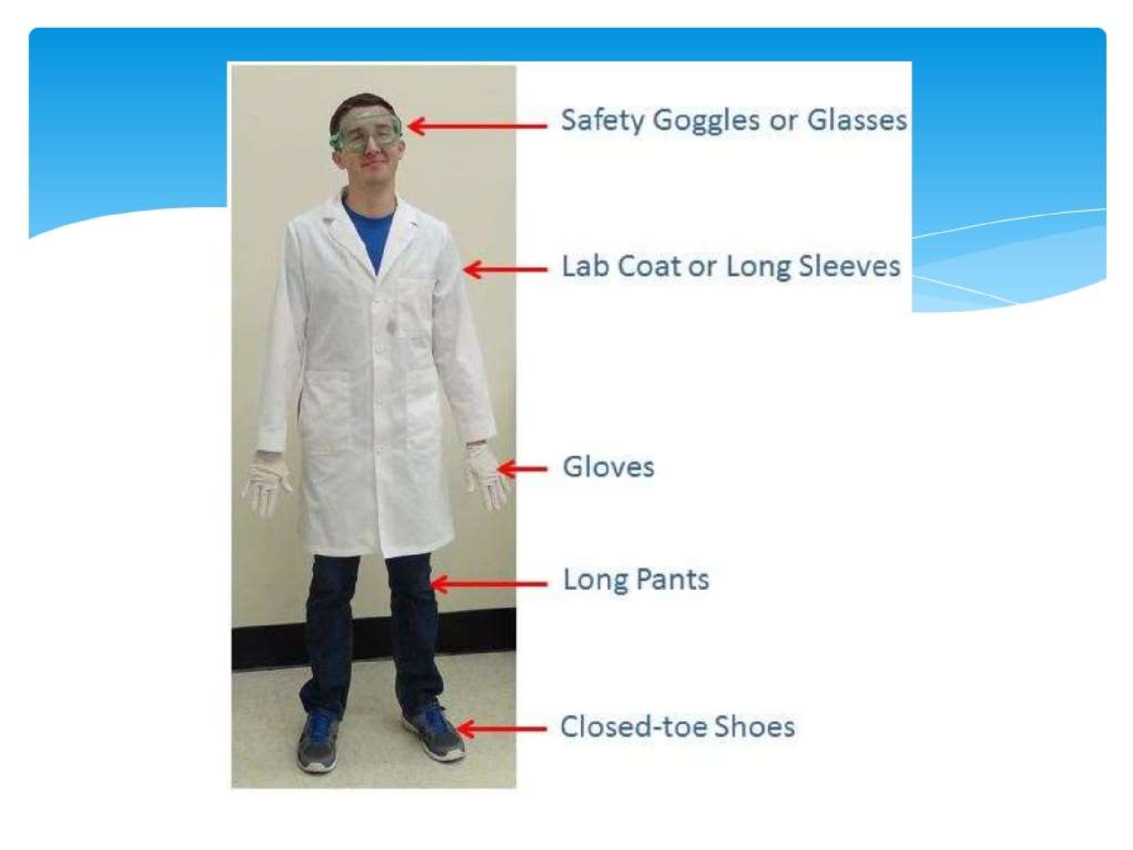

Slide 50
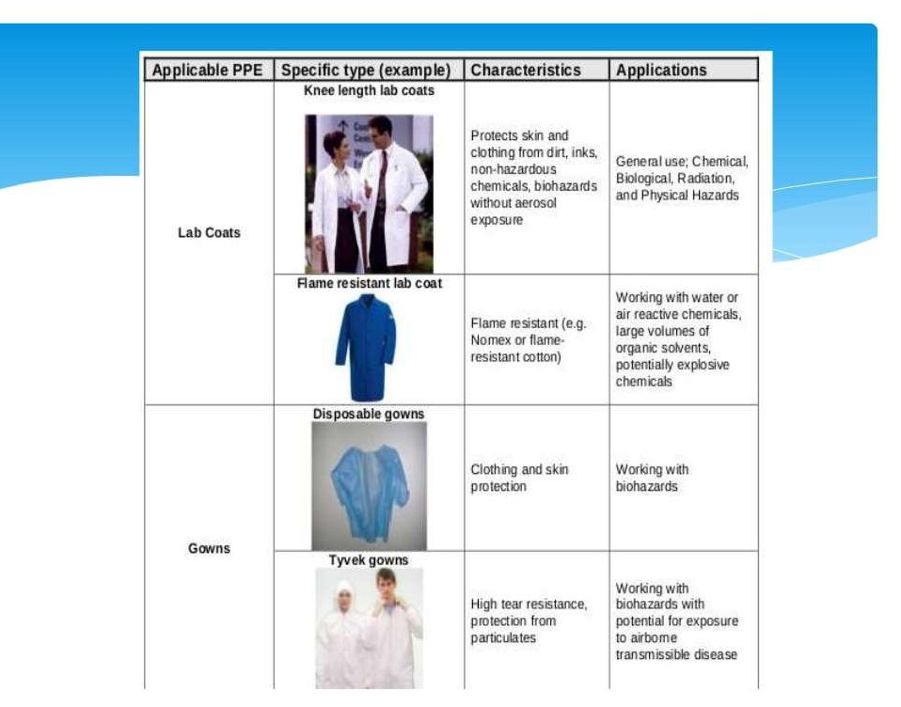

Slide 51
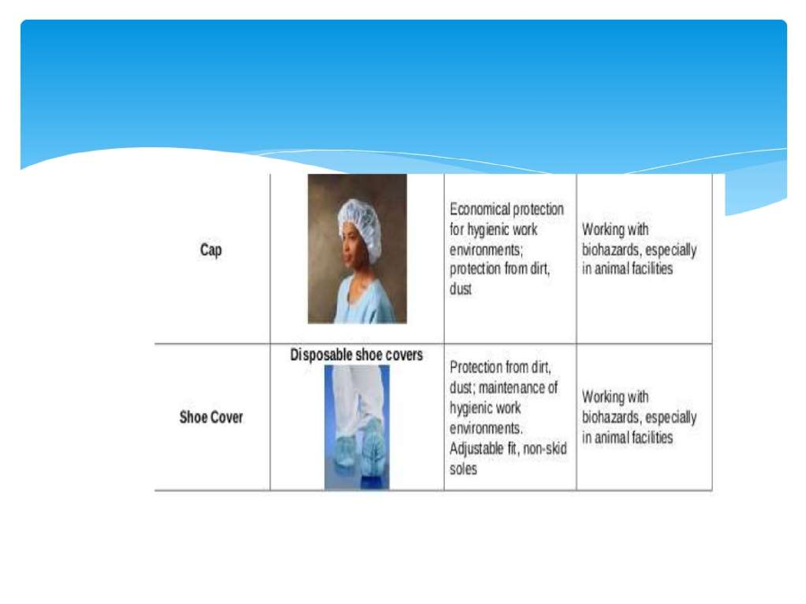

Slide 52
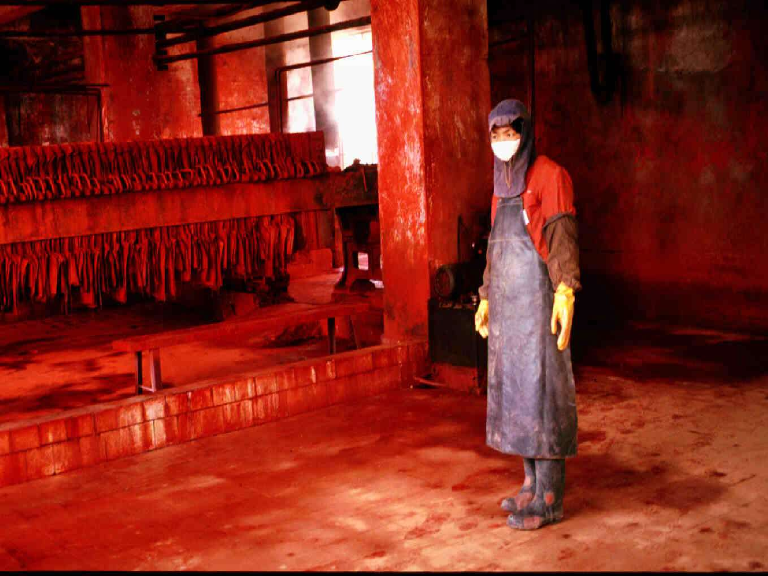

Slide 53
General Tips for Chemical Safety
Read the warning labels on any chemical before you use it.
Remember that an unlabeled chemical is a dangerous one. ever sniff or smell an unlabeled chemical.
Followthe directions and precautions listed on the label and ways dispose of a chemical properly.

Slide 54
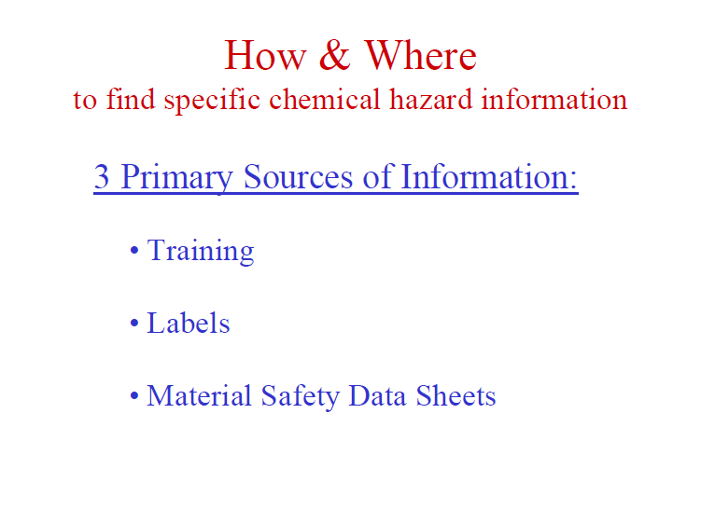

Slide 55
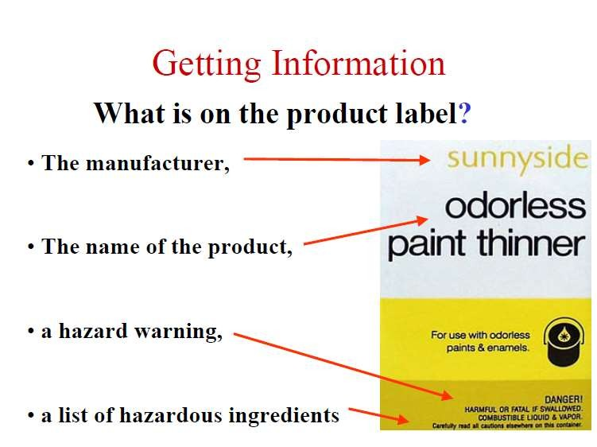

Slide 56
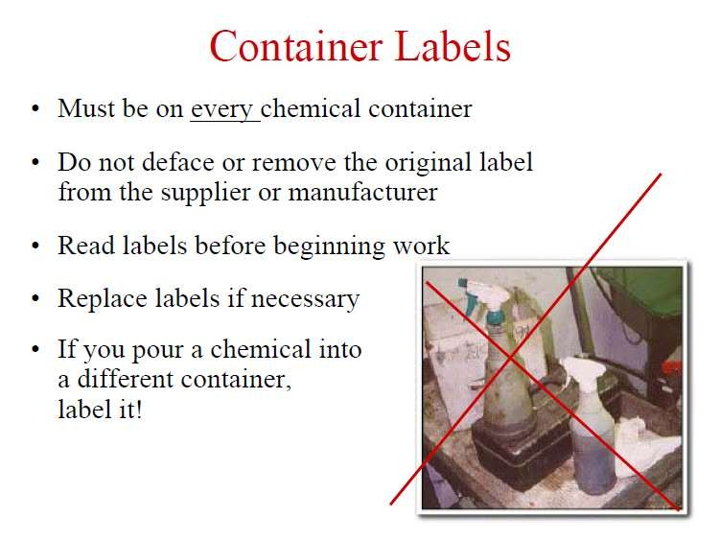

Slide 57
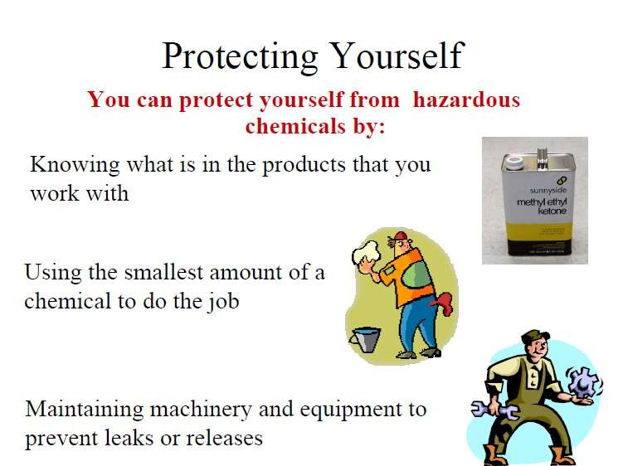

Slide 58


Slide 59


Slide 60

TOXICOLOGY

Slide 61
“All substance are poisons”; there is none, which is not a poison. The dose differentiates a poison and a remedy.

Slide 62
Sources of Toxin:
Environment
Food/Feed/Water
Drugs

Slide 63
Environment
Air Pollution
Carbone monoxide
Nitrogen oxides
Smoke
Poor Ventilation
Ammonia, Hydrogen Sulfide
Volatile Compounds
Chlorine, Hydrocarbon fuels

Slide 64
Toxicity
Toxicity is the degree to which a substance can damage an organism.
Toxicity can refer to the effect on a whole organism, such as an animal, bacterium, or plant as well as the effect on a substructure of the organism, such as a cell (cytotoxicity)or an organ such as the liver (hepatotoxicity).
Toxicity is the capacity of a chemical compound to produce injury.

Slide 65
Some possible outcomes of Toxicant:
Death after a short period of time- Acute toxicity
Cancer / mutation in DNA
Skin / eye irritation
Fertility problems
Carcinogenicity / mutagenicity
Reproduction effects
Sudden heart failure and death

Slide 66


Slide 67


Slide 68
Types of Toxicity
Acute toxicity
Sub-acute toxicity
Sub-chronic toxicity
Chronic toxicity

Slide 69
Conditions of strong poisoning
High temperature
Deep or rapid breathing
Long working hours
Combination of two or more poisonous substance

Slide 70
Median Lethal Concentration (LC₅₀)-
In toxicology, the median lethal dose, LD₅₀, LC₅₀ is a measure of the lethal dose of a toxin, radiation, or pathogen.
^{LC}50:
Concentration of a toxicant
(mg/m³) in air to kill 50% of the
animals exposed
for the specific
length of time.
^{LD}50:
Lethal Dosage 50
LD₅₀ is the amount of a material, given all at once, which causes the death of 50% (one half) of a group of test animals. The LD₅₀ is one way to measure the short-term poisoning potential (acute toxicity) of a material

Slide 71
Threshold Limit Value (TLV)
TLVs are generally defined as air concentrations of chemicals that most workers can be exposed to for an 8-h workday, 40h per week for a working lifetime without suffering adverse effects.
Short-term exposure limit (STEL) is a 15-min time-weighted average exposure that should not be exceeded during the workday even if the 8-h TWA is within the TLV.
•Exposures at the STEL should not be repeated more than four times per day
Zone A – irritation
Zone B – coughing
Zone C – breathing difficulty
Zone D – collapse
Zone E – death

Slide 72


Slide 73


Slide 74


